Slide 1
PARTICIPATORY LAB: INTEGRATED CARE (SESSION B)
DRIVING COLLABORATION ACROSS DEPARTMENTS AND BORDERS
with
Alessandro Pingitore
Researcher at the National Research Council, Italy
Antonella Pollazzi
Policy officer, Tuscany Region, EU Liaison Office, Brussels
moderated by
Carlo Sacchi
Business Development Manager- South Est Europe, Siemens Healthineers Italy

Slide 2
Programme and goals of the session
PROGRAMME | Hear from Alessandro Pingitore and Antonella Pollazzi on how the Tuscany Region (Italy) successfully leveraged EU funds for driving collaboration across departments and borders Hold an interactive discussion on the needs and challenges for unlocking EU regional funds in the area of integrated care Wrap-up discussions and agree on the main take-aways of the session for presenting in the final plenary
Discussing the added value of replicating the best practice presented in other EU regions Exploring the priority needs for regional funding in the area of integrated care and what the focus of future activities should be Understanding what the current challenges are in leveraging EU funds for fostering health regional development, including through projects focusing on integrated care Contributing to the policy recommendations in the final report of the event |  | GOALS

Slide 3





POR-FESR 2014-2020
Research on the Appriopriateness in cardiology care based on data evidence - Ricerca sull’Appropriatezza in Cardiologia con Evidenza dei dati

Slide 4
Programme and goals of the session
Project RACE: 2.127.500 euro (ERDF, European Regional Development Fund)
Regional Operational Programme 2014/2020 (Axis 1 – Strengthen Research, Technological Development and Innovation.
The RACE project evaluated strategic for regional cohesion policy since it is:
In line with the priorities of the Tuscany Region’s Smart Specialization Strategy - RIS3 (priority n. 1 – ICT&Photonics) - The revised RIS3 (Mid Term Review of February 2019) identifies two specific roadmaps for the development of the Health/Life Science application fields, notably: ICT for health and enabling technologies and infrastructure for health. Interventions with similar approaches could be submitted in future calls (projects submitted under call 2020 are currently under evaluation).
Innovative (even in terms of knowledge advancement) and market oriented
Promising in terms of jobs creation and development of “specialised areas”.
Promotes cooperation and networking between researchers, public hospitals and enterprises (also between Gis and SMEs)

Slide 5

Clinical background
Why choosing the cardiac patient
Causes of deaths in Europe, 2017
Men
Heart diseases, in particular ischemic and ischemic and non-ischemic heart failure (HF), are the most frequent causes of morbidity and mortality in the West.
Heart Failure (HF) begins as an organ disease, from the heart, characterized by the reduction of contractility and dilation of the volume of the left ventricle.
In its evolution, it becomes a systemic disease, with the involvement of other organs and the chronic activation of the neurormonal systems, the inflammatory and immune systems.
1) It requires chronic therapy and continuous clinical assistance
2) High morbidity and mortality
3) High levels of healthcare management costs
Women
High cost for the European Community. The global estimate is around 196 Euro/year, with a productivity loss of 24%.
Chronic degenerative disease, for which continuous assistance is required also for the purpose of reducing hospitalizations and costs.

Slide 6












Aim of the RACE project was the development of advanced tools to support the implementation of in-hospital pathways and hospital-community for patients with chronic heart failure
A strict relationship between
Factories
Clinics
Research
Architecture of RACE project
Technological
Appropriateness
Economic
Appropriateness
Clinical
Appropriateness
Integration Systems And Semantic interaction
In-Hospital and
Hospital-Territory (home) carepaths
with postural and vital parameters
detection devices

Slide 7
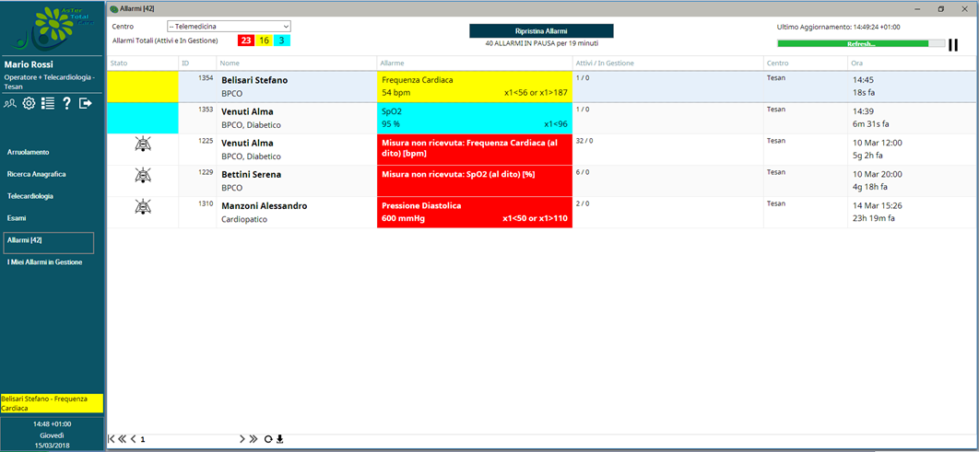
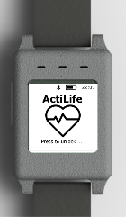
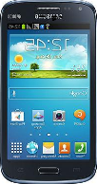
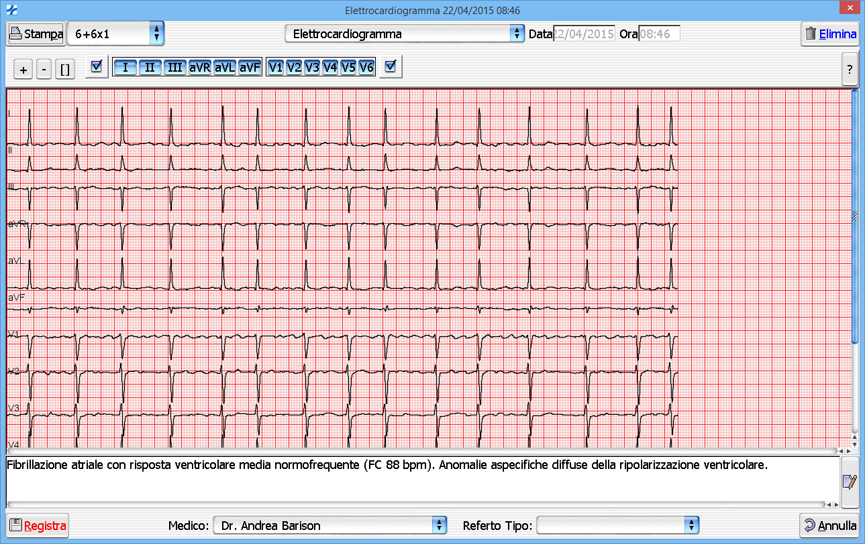
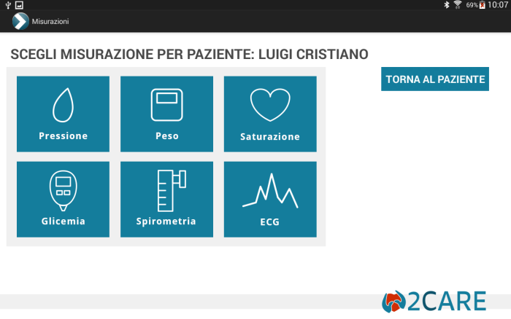
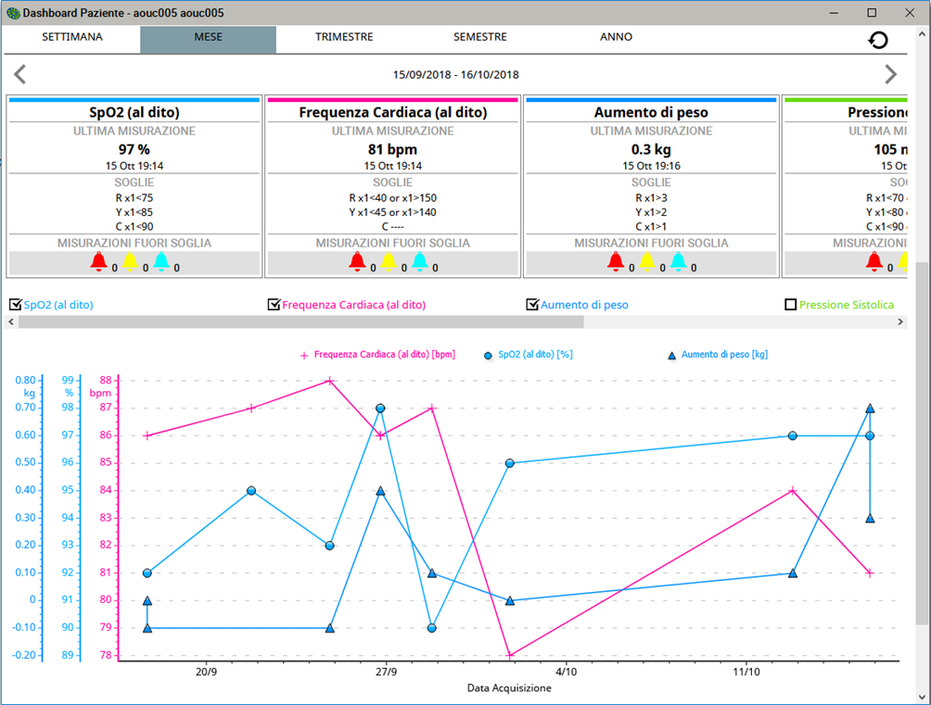
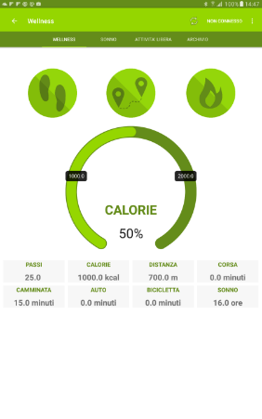
Main Results, Technological Appropriateness
Telemonitoring system development
Usability, Human Interface, integrability and interoperability Allarm Management, Data Collection Archiving, and analysis for Clinical Decision Support System,

Slide 8
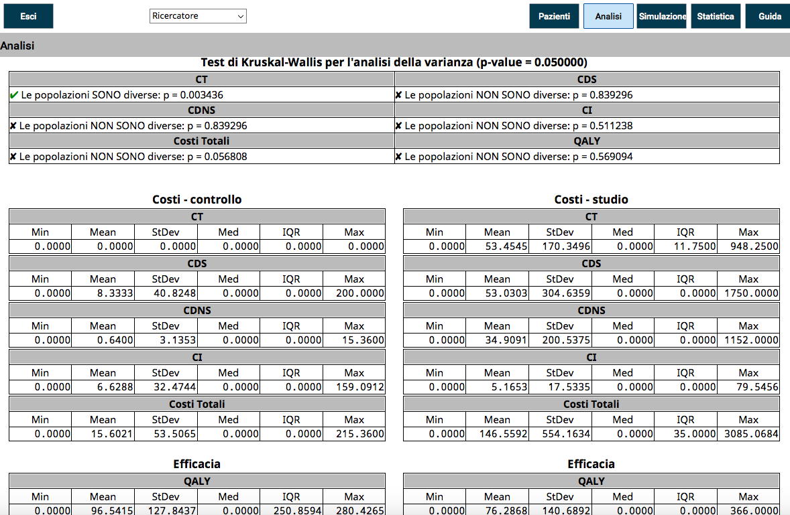
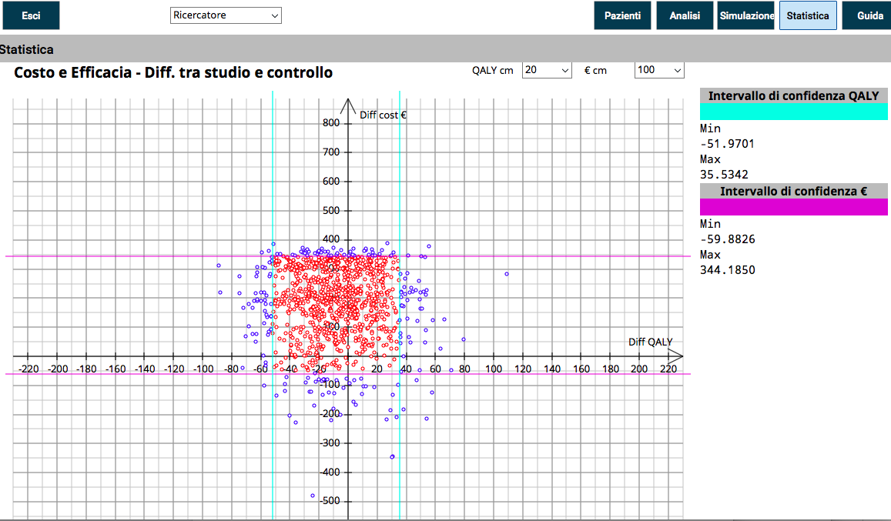
Main Results, Economic Appropriateness
First result: an economic decision support system
A prototype of an economic decision support system through the implementation of a multi-user platform able:
to collect, integrate and analyze data coming from patients and hospital
to assess real time short run and simulate the medium and long run cost-effectiveness (efficiency) of alternative effective therapies
to support the healthcare professionals and the health policy decision-makers’ decisions
Second results: RACE cost effectiveness
Through the platform, we assessed the incremental cost- effectiveness (ICER) of RACE with respect to the standard
(effectiveness measured in terms of QALY - quality adjusted life years)
The control and study group have the same QALY
As expected (it is an observational study) the control and study groups differ only on costs for the dedicated new technology.
Since the other costs and QoL are the same, it is expected that an interventional study can assess the reduction of direct health, non- health and indirect costs induced by the adoption of RACE, also considering its role in decongesting the hospital facilities, in the COVID era.
The above analysis and figures are automatically generated by the platform

Slide 9
Main Results, Clinical Appropriateness
HOLISTIC CARE
GREATER HEALTH OUTCOMES
BENEFITS OF THE INTEGRATED CARE MODEL
The results show how the use of telemedicine in patients with chronic disease can support the management of the disease not only from a strictly clinical, but also from a psychological point of view.
Patients felt more confident in their physical abilities, particularly the less clinically compromised patients showed greater restoration of daily activities associated with a better perception of well-being.
The clinical results show the benefit of the integrated hospital-territory path model for cardiology care through telemedicine thanks to:
Observation of monitored parameters to prevent the worsening of clinical outcomes
Comorbidity monitoring
Optimization of therapy
Improvement of the quality of life

Slide 10


Future Perspectives
Why Telemedicine
1) Early diagnosis of clinical worsening
2) Availability of clinical data at home to improve therapeutic and diagnostic decision making process
3) Improvement in quality of life of patient
4) Increase in awareness of own health status from patient
5) Optimization of therapy
6) Improvement of economic sustainability of healthcare system
Where to Apply Telemedicine
1) Chronic degenerative diseases
2) Congenital Heart disease
3) Rehabilitation field
Approccio Innovativo peR la CARDIOpatia congenita
What’s the carefulness
Engagement systems to favor the use of telemedicine patients
2) Do not think telemedicine «alter ego» of the doctor

Slide 11

POR-FESR 2014-2020
TUSCANY REGION
Elisa NANNICINI
Head of the Business Support Policies Department
elisa.nannicini@regione.toscana.it
Antonella POLLAZZI
EU Liaison Office, Brussels - Policy officer
antonella.pollazzi@regione.toscana.it
NATIONAL RESEARCH COUNCIL
Alessandro PINGITORE
Researcher
pingi@ifc.cnr.it

Slide 12


Slide 13


Slide 14


Slide 15
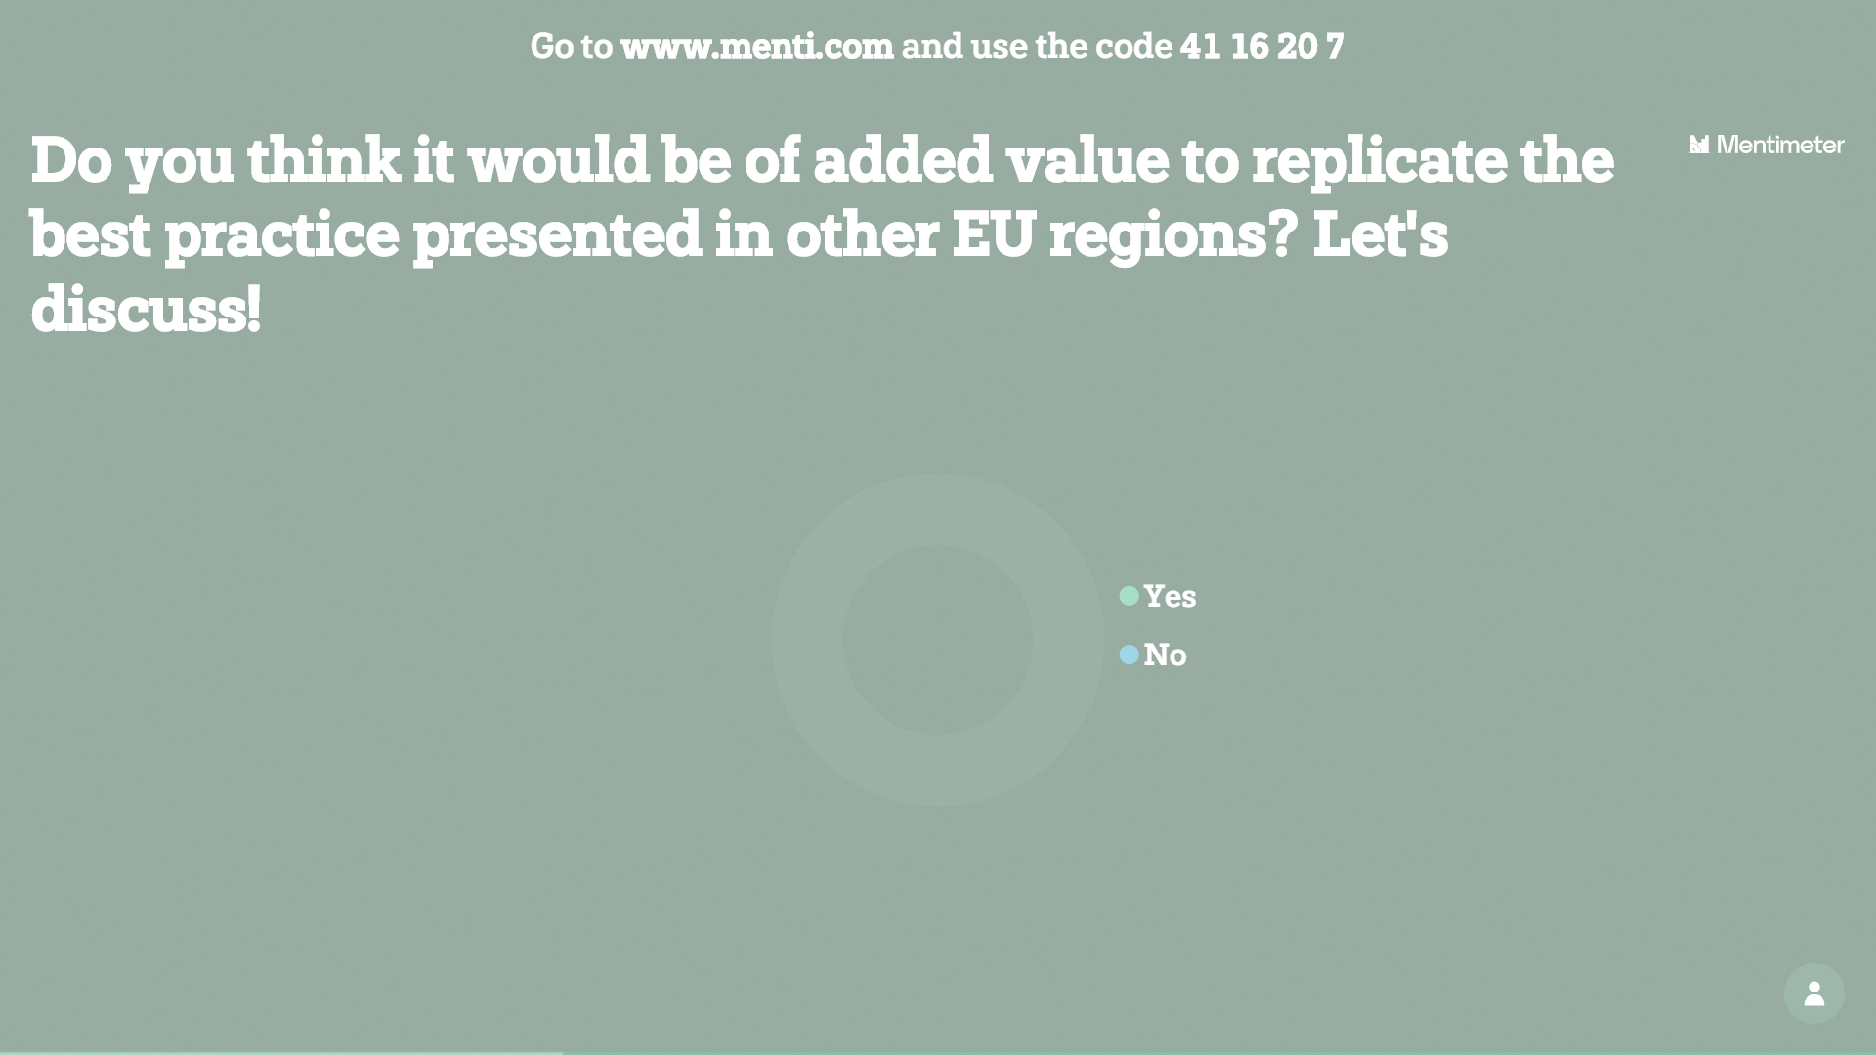

Slide 16
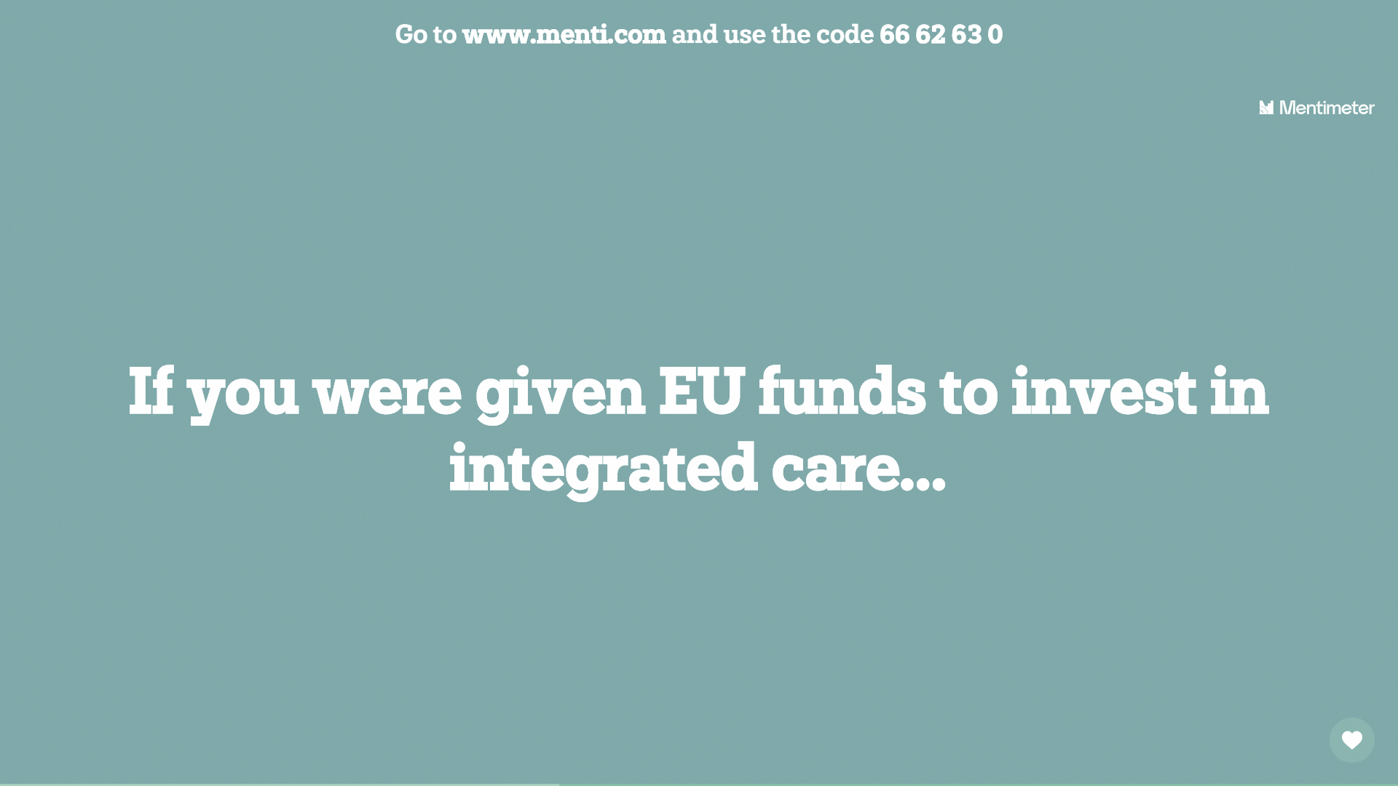

Slide 17
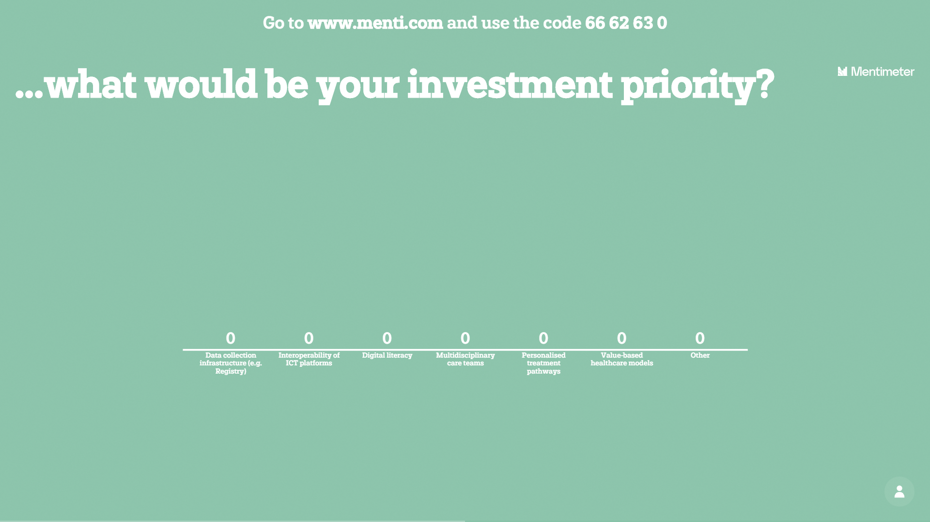

Slide 18
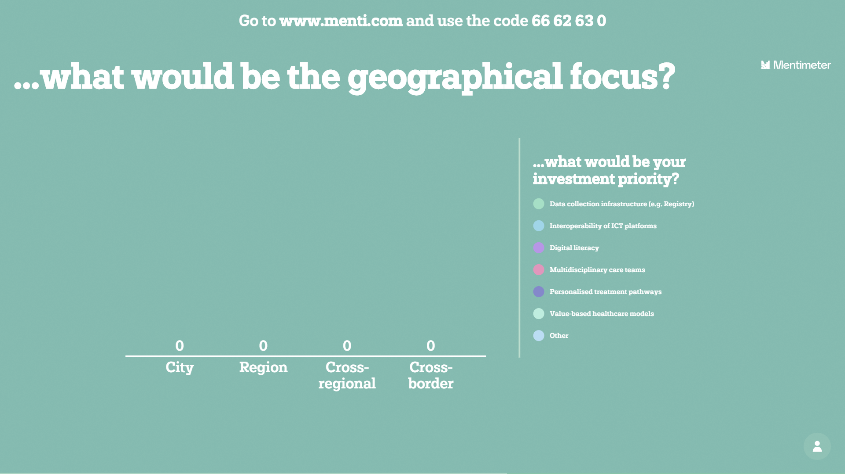

Slide 19


Slide 20
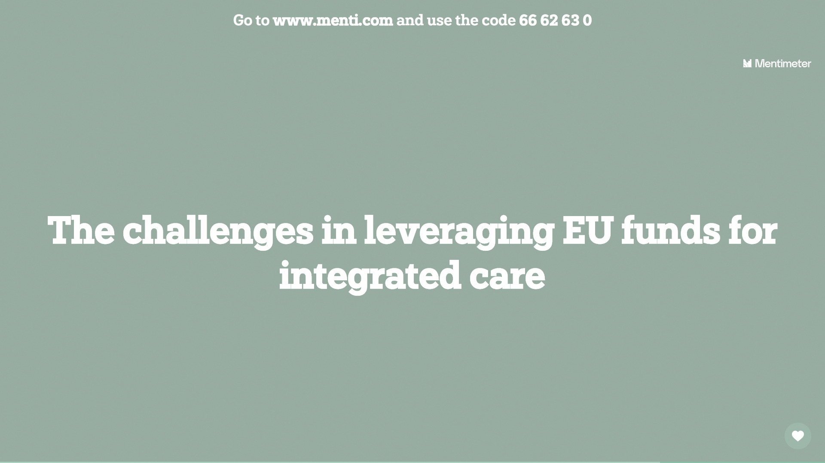

Slide 21
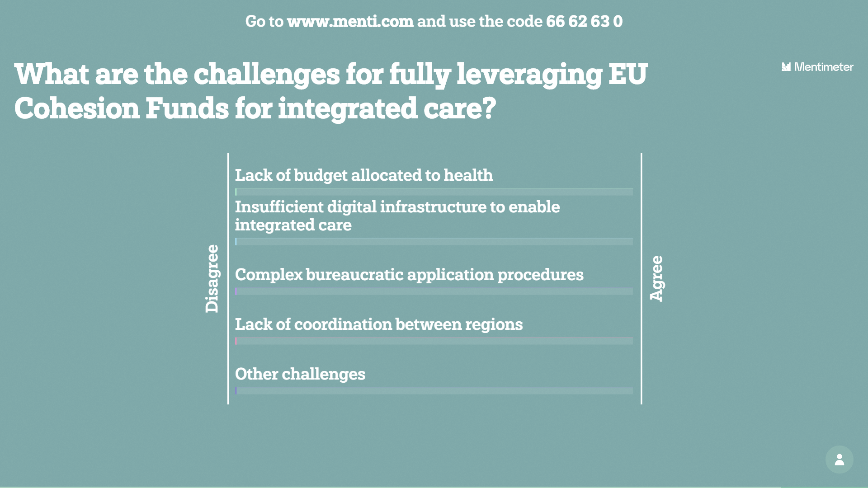

Slide 22


Slide 23
Session B: Integrated Care
Key take-aways
KEY PRIORITIES
X
KEY CHALLENGES
X
KEY SUCCESS FACTORS
X

